Slide 1
Mrs. Hardiman’s Class Cedar Creek Elementary Back to School Morning August 28, 2018

Slide 2
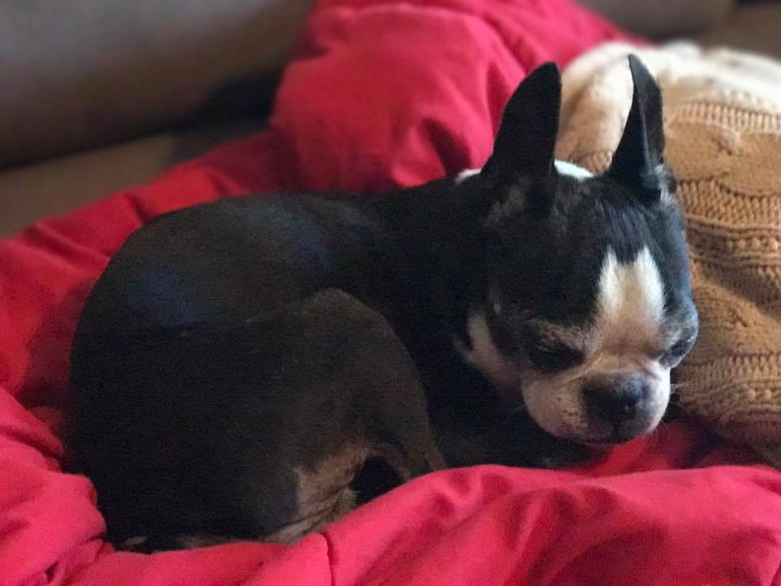
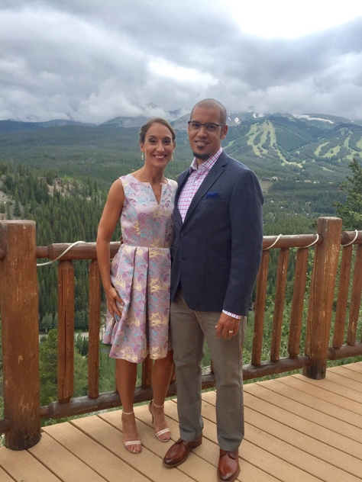
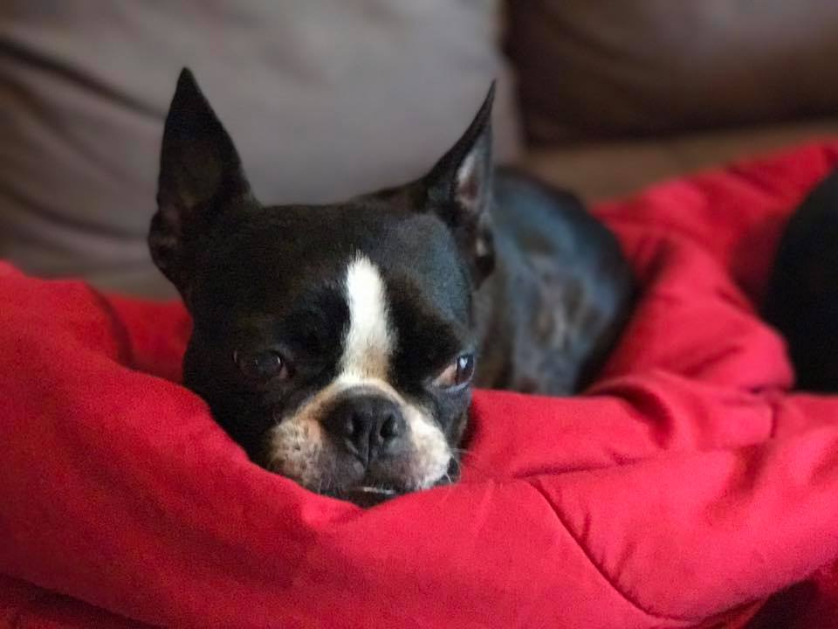

Slide 3
Daily Schedule
7:40-7:55 Morning Meeting in Classroom 8:00-9:45 Language Arts 9:45-10:30 FIT 10:35-11:00 Recess 11:00-11:25 Lunch 11:25-12:15 Science/Social Studies 12:15-1:05 Specials (A Day- P.E B Day- Art C Day- Music) 1:05-1:20 Math 1:20-1:40 Recess 1:40-2:40 Math 2:40-2:45 Pack-Up, Clean Up 2:50 Dismissal Library: Every other Tuesday for check out 8:00-8:15am

Slide 4
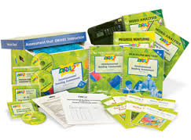
Assessments
Reading Comprehension Assessments and Checks
End of Unit Math Assessments
DRA
The DRA is used to identify each student’s instructional reading level and provides information about the child’s reading engagement, fluency and comprehension. We will discuss your child’s level in October at Parent/Teacher Conferences.
Eanes ISD also asses student reading comprehension,
fluency, and accuracy using the Istation Assessment System. These assessments are conducted quarterly.
Writing is assessed through Writing Workshop model.

Slide 5
Curriculum
Language Arts:
Reading/Writer’s Workshop,
phonics/spelling(district continuum,)
Reading Street, Guided Reading Books,
Small and Large Group Reading Strategy and Skill Instruction,
Handwriting Without Tears.
Math: Envision Math, Number Talks, Investigations, Math Coaches Corner, Small and Large Group Guided Math
Science and Social Studies
*Maps and globes *Economics *Government and citizenship *Objects in the sky *Forces: balance and motion *Insects and plants *Air/weather/earth *Ecosystems: Sandy shorelines

Slide 6
Grading
Eanes ISD follows the State and District Mandated TEKS. Students will be assessed and determined if they “Meet Expectations” (M) –student consistently demonstrates the skill or understands concepts at the level expected for the reporting period (80%), or “Not Meeting Expectations Yet” (N/M)- Student does not consistently demonstrate the skill or understands concepts at the level expected for the reporting. NA- Not Assessed or applicable for grading period.
If your child receives an “NM” it is not cause for concern, these are end of the year goals.

Slide 7
Behavior Management
*SEL-Social Emotional Learning
*Morning Meetings
I like to think of our classroom as a small community where we work, play, learn and laugh together. Kindness is the norm that is modeled and reinforced constantly and consistently throughout the day. Instead of swooping down on what is wrong, we like to capture what is right! If your student is having difficulty with behavior, I will be discussing this with them personally and contacting you. We use a variety of PBS strategies in our room such as: Rockin Rewards, Whole Class/Individual Rewards, SEL lessons, and Second Step.

Slide 8
Tally and Sticker/Ticket System
I will be using several behavior systems this year. The systems I will be using are the tally system to manage behaviors along with a reward system to reinforce expected routines and behaviors. These systems are subject to change at any given time throughout the year depending upon student success. Classroom behavior systems are not the end-all be-all when it comes to behavior management. Just like the lessons I teach, are not one size fits all. Therefore, if the classroom behavior system doesn’t fit your child, I’ll begin and individualized system to meet their needs.

Slide 9
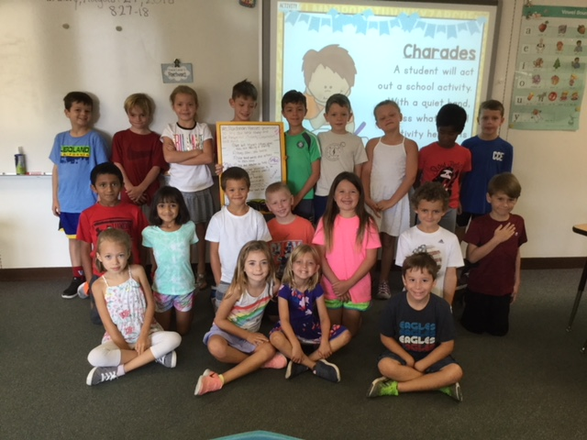
Classroom Rules

Slide 10
Snacks
Provide healthy snacks such as fruit or vegetables (NOTE: Snacks must be peanut and tree nut free)
Easily opened
Not messy or drippy
Please do NOT send sugary snacks

Slide 11
Birthdays
Teachers will have a surprise for the birthday boy or girl.
Food items will not be passed out to share with classmates.
If you have a birthday party here at school, please provide for the teachers a list of children attending.

Slide 12
Arrival & Dismissal
7:40 Arrival-in cafeteria, adult supervision is available starting at 7:15 in the cafeteria.
Tardies: Everyone is late on occasion, we understand☺ However, consistent tardies can be very upsetting to your child and get him/her off on “the wrong foot” once they arrive at school. We all appreciate students arriving on time.
School is dismissed from 2:45-2:50.
All transportation changes need to be done by 1:30 p.m. each day and entered into Campus Dismissal Manager. No guest ridership on the buses this year. All playdates should be arranged before students come to school.
Please display the “yellow” second grade sign on your windshield, if you need an extra please let me know.
PLEASE, PLEASE, pull your car forward to the furthest available position in the car line. If you need to leave your vehicle please park and walk in to the building.
Please use all available crosswalks if you leave your car.
The bus lane opens for cars when ALL the buses have dropped off
Say your goodbyes before you get in car line
Put all devices away before you get in the car line
Do not go around cars or buses, wait in the car line and move with the traffic
If you need to get out of the driver seat, park. Do not get out of the car in the car line.
Be patient especially on ​rainy days​

Slide 13
Additional Attendance Information
Please enter all absences into the Parent Portal. Emails and phone calls will not be accepted.
Arrival after 10am counted as absent. (doctor’s note needed)
3 or more days Extended Leave of Absence completed and returned to front office.

Slide 14
Take Home Folders
1. Read aloud for at least 10 minutes
2. End of Unit Math Review Sheet
3. Daily work *on occasion*
4. Please remove papers daily and return to school the following day.
5. Daily Reading/Comment log

Slide 15
Thursday Folders
Will include:
Communication from office staff and Booster Club
Graded and/or completed work
Please go over graded work with your child. Often this is the first they have seen it.
*Empty and return folders the next school day

Slide 16
Star Student
Throughout the year each student will have an
opportunity to be our Star Student!
Monday- Bring in 5-6 photos to share and display on the bulletin board
Tuesday- Write a letter to your child telling them why you think they are wonderful and how proud you are of them.
Wednesday- Bring a favorite book to do a “book review”
Thursday- Lunch with Mrs. Hardiman and a friend from 2nd grade
Friday- Receive his/her compliment book

Slide 17
Parent Involvement
Room Parent- WE NEED 1 MORE ☺
End of Year Party Helpers
Fall Family Fun Representative
Book Fair Volunteers
Math Volunteer
Office Support Volunteers

Slide 18
Stay Connected!
I will send out a weekly email blast every Thursday with important information for the upcoming week. You can also access my classroom website through the CCE home page and the current newsletter will be posted there as well.
My Email: shardiman@eanesisd.net
School Phone: (512) 732-9120 x 22145
Best way to contact me is through email.
If you would like to set up a conference, the best times are 12:15-1:05 or after school, please email me to schedule.

Slide 19
Welcome to a great year in 2nd Grade!

